Slide 1
Celera Group
Group members：
SamrudDhi Kaulapure, Shruti KHETAN, Siyuan Han, Zhe Tang

Slide 2
Agenda
Introduction
Section 1: Company History
Section 2: Project Description
Section 3: Project Reflection
Summary and Questions

Slide 3
Section 1: Company History Celera Group
Name: Celera Group
What does the company do: It is a diversified financial industry group of companies, with holdings in the brokerage to financial technology sectors.
Mission:
Company’s stakeholders: Celera Group is privately owned by TCG Capital, a family office with a Greater China background in the chemicals and electronics industries dating back to 1918 in Shanghai, China, 1950 in Hong Kong and 1970 in Taiwan. Celera Group is headed by its Chairman and CEO, Eric Wong, who is also a member of the founding family of TCG Capital.
Target customers:

Slide 4
Section 2: Project Description
Description: Students will be helping to build our proprietary Risk Engine, solving problems related to evaluating commodity derivatives portfolio risk.
Timeline: 10 hours a week for 10 weeks.
Supervisors: Sammy, William
Each members role:
Work done:
Project outcome:

Slide 5
The Project - agenda
Step 1: Building a Pricing engine (Data from MongoDB using Python)
Step 2: Building the Risk engine using modeling techniques
Step 3: Machine Learning Analysis (to determine states from the data)
Step 4: Testing on future data, derive distributions, analyze portfolio
Step 5: Back-testing strategy

Slide 6
Actual Project Plan
Monte Carlo Simulation Model
Step1: Database
Step 2: Optimization(prototyping)- find parameters
Step 3: Back-testing – with known data
Step4: Simulations (mimic step3)- with unknown data
Step 5: Pricing Engine (Price Options & Strategy)
Step 6: Risk management (Ultimate goal of the project)

Slide 7
Detailed steps
Step1: Database - mongodb
Step 2: Optimization- GARCH, Stocastic futures price, prototype spreadsheet, parameters: alpha, gamma in Garch
Step 3: Back-testing – with known data (Can you produce the error that matches the error)
Step4: Simulations (mimic step3)- with unknown data
Step 5: Pricing Engine (Price Options & Strategy)- Price options: ATM Call, Put, Straddle
Step 6: Risk management (Ultimate goal of the project)

Slide 8
Step 1: pricing engine
STEPS
Data from Quandl
Robomongo
Data frames
Monte carlo

Slide 9
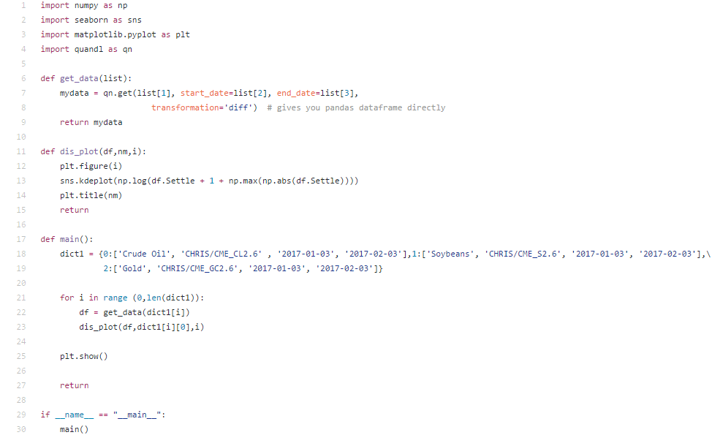
Black sholes model

Slide 10
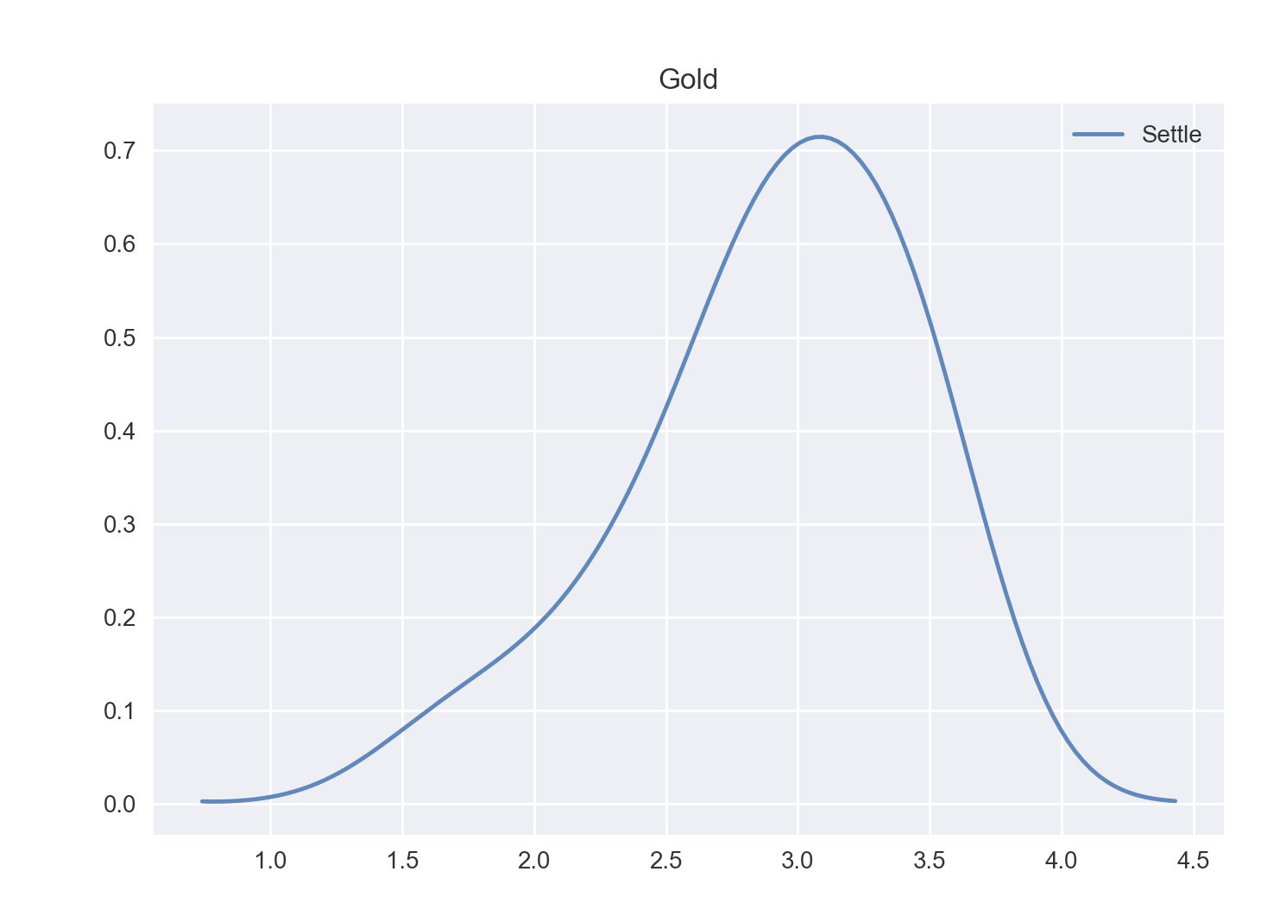
The results we get

Slide 11
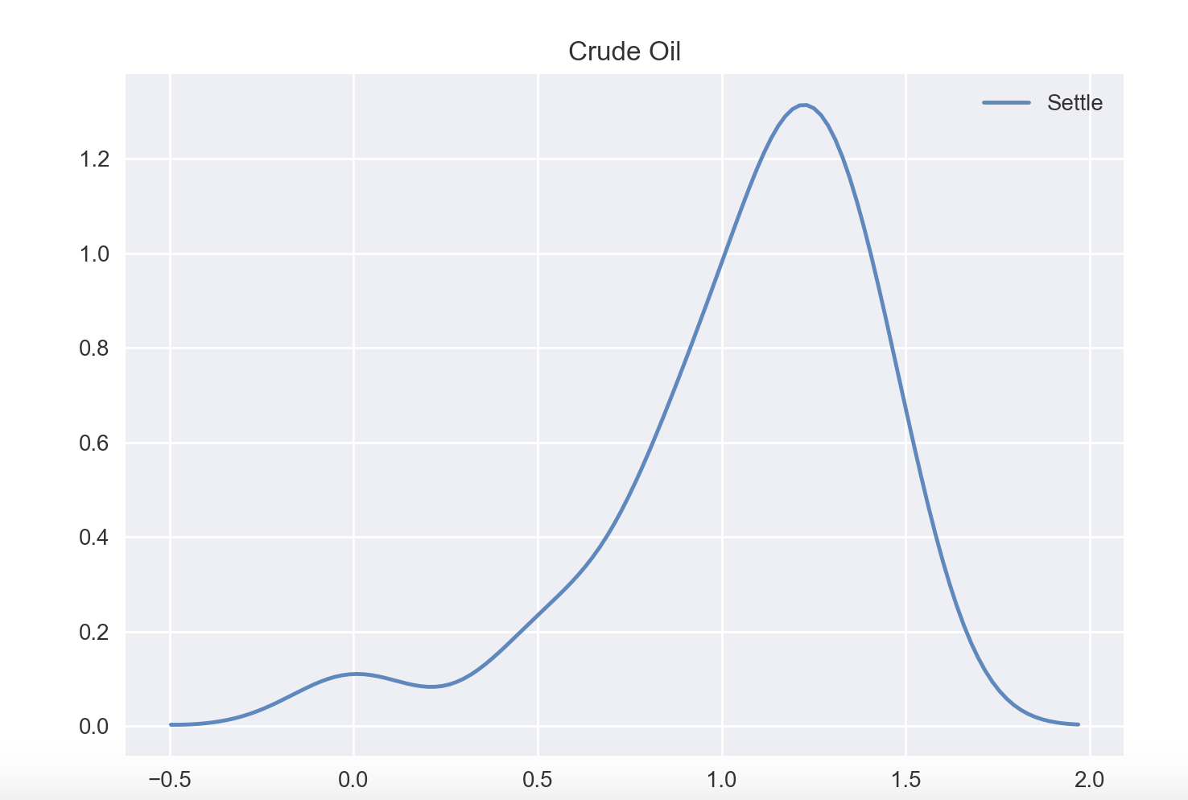

Slide 12
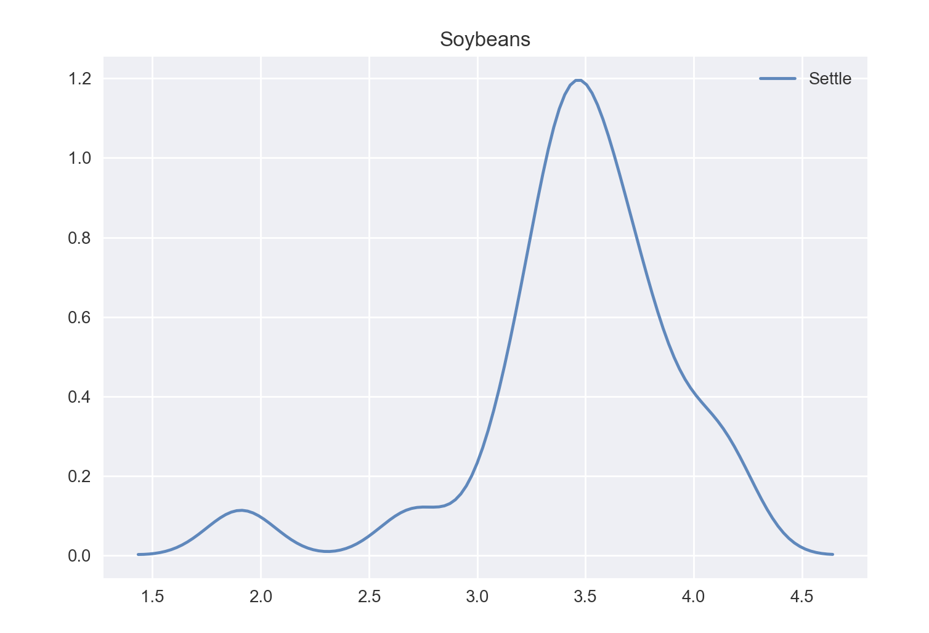

Slide 13
Monte carlo simulation
Distribution parameters used:
Similarities in the distribution of the 3 results:

Slide 14
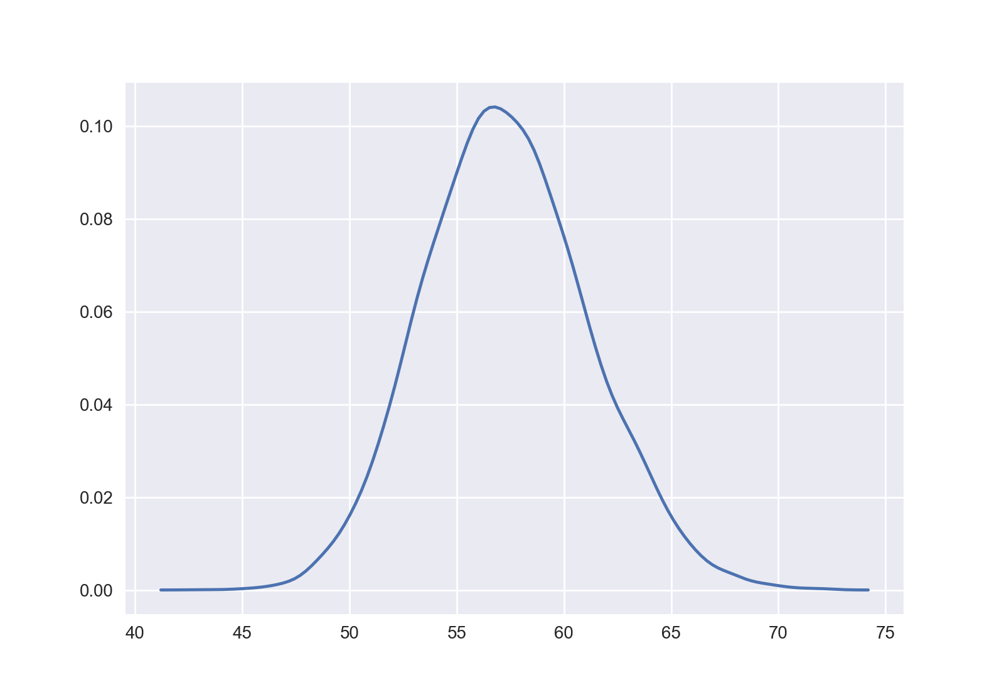
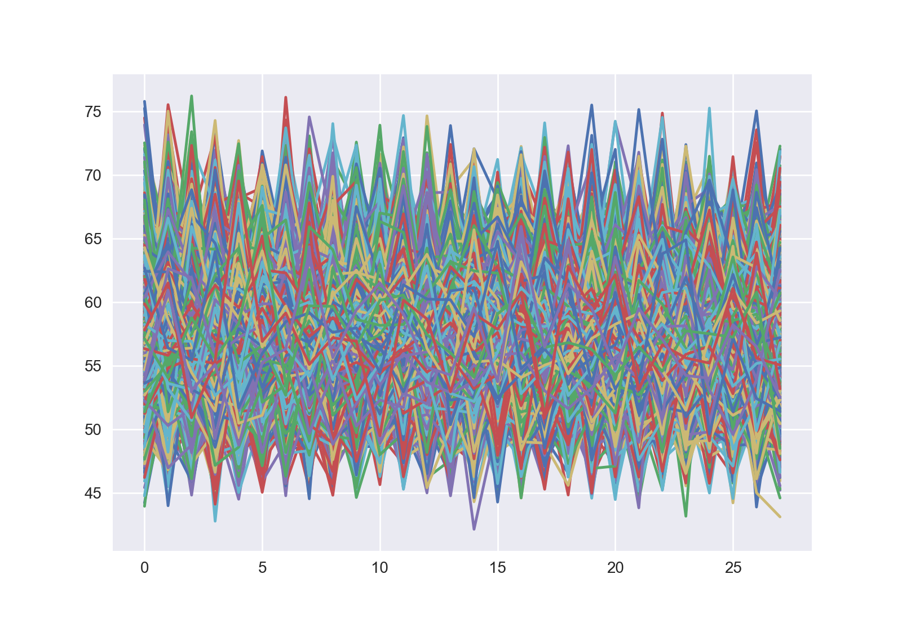
result of monte carlo simulation:

Slide 15
Step 2: risk engine
GARCH Model
Implied volatility and realized volatility calculation
Fitting GARCH on the futures time series data
Calculating GREEKS
Monte carlo simulations

Slide 16
garch
Formulas:
F1=F0.exp(
Risk
Bootstrapping

Slide 17
Iv and rv
Implied volatility calculation on futures time series data using Newton’s method(closed form solution guess)
IV for American Options = best guess is IV for European Options

Slide 18
Machine Learning
Market regimes
Z scores
Interest rates
Clustering

Slide 19
Limitations
We are using Python which isn’t as fast a programming language
This sometimes makes it difficult to compete with other firms

Slide 20
Section 3: Project reflection

Slide 21
summary

Slide 22
Thank you. Any questions?

